Slide 1
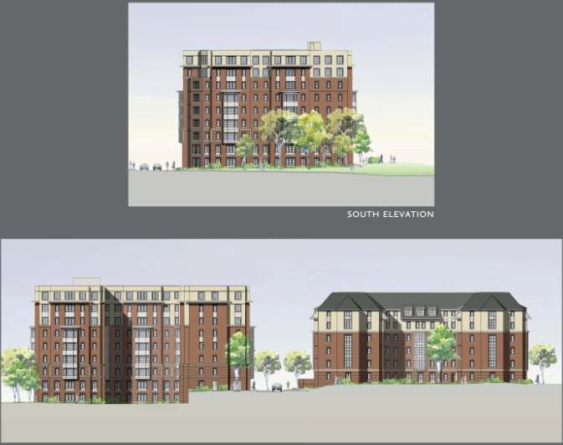
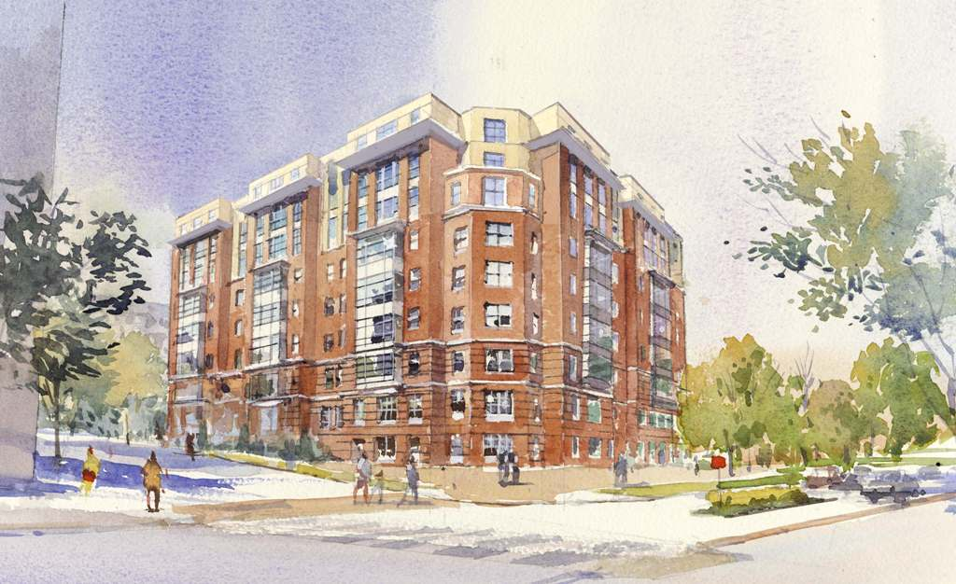
University of Maryland Dorm Building 7
6801 Preinkert Drive College Park, MD 20742
Ryan L Solnosky
Structural Option MAE/BAE
Advisor: Dr. Ali Memari
Spring 2009

Slide 2
Presentation Outline
Introduction & Building Overview
    Building Statistics
    Architecture
    Existing Structure Overview
Structural Depth Study
    Thesis Goals
    Design Codes
    Computer Modeling
    Gravity Design
    Gravity Connections
    Lateral Procedure and Loads
    Lateral Design
    Lateral Connections
    Alternatives and Implications
    Foundation Considerations
    Goal Summary
Green Roof Breadth Study
    Material and Considerations
    Green Roof Layout and Design
    Water Collection System Design
    LEED and Impacts
Conclusions & Recommendations
Questions?

Slide 3
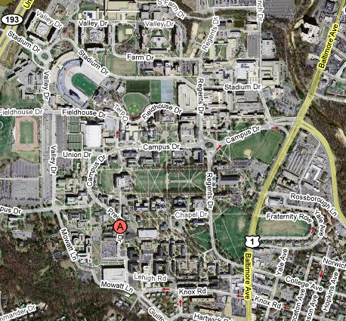
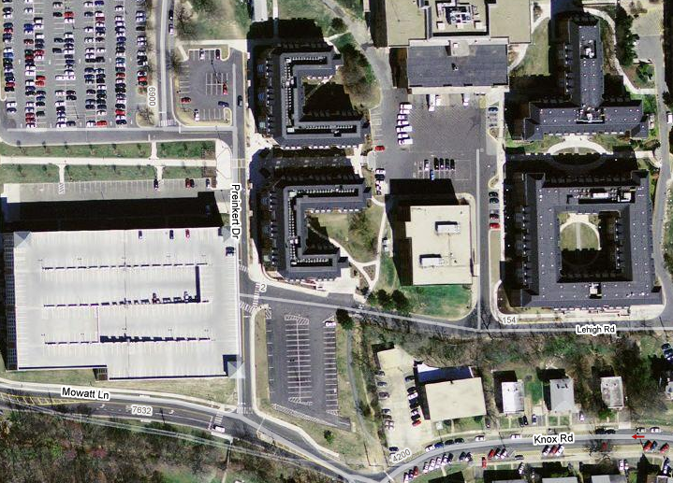
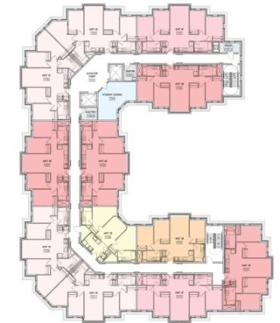
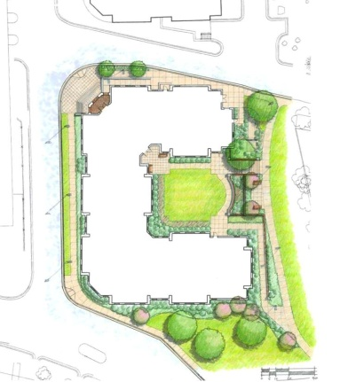
Presentation Outline
Building Statistics
Introduction & Building Overview
    Building Statistics
    Architecture
    Existing Structure Overview
Structural Depth Study
Conclusions & Recommendations
Questions?
Location: 6801 Preinkert Drive College Park, MD 20742
Architecture: U-Shape Plan
9 Stories including the Terrace Level
Units are designed for 2-4 people
Total Height 94’
Building Use: Dormitory/Apartments
Office Space for Building Housing
        Size: 133,000 Square Feet
        Cost: $23.5 Million
        Structure: Light-gage Bearing walls and Shear walls with Concrete Columns and Shear walls
        MEP: Each unit is separately heated and cooled by 111 rooftop mechanical units
        LEED: Currently approaching a LEED Gold Standard

Slide 4
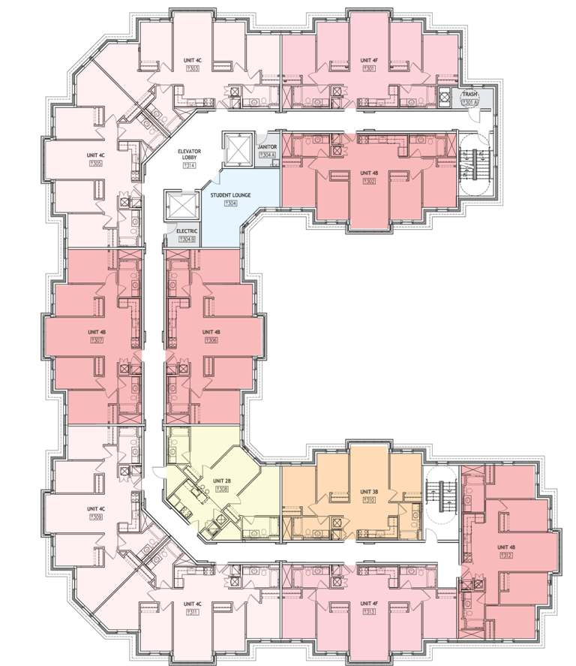
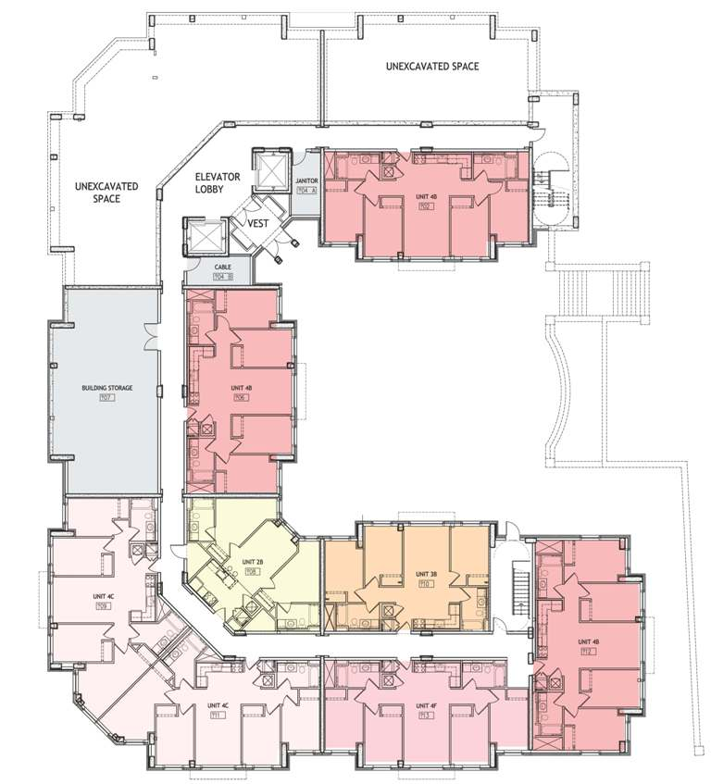
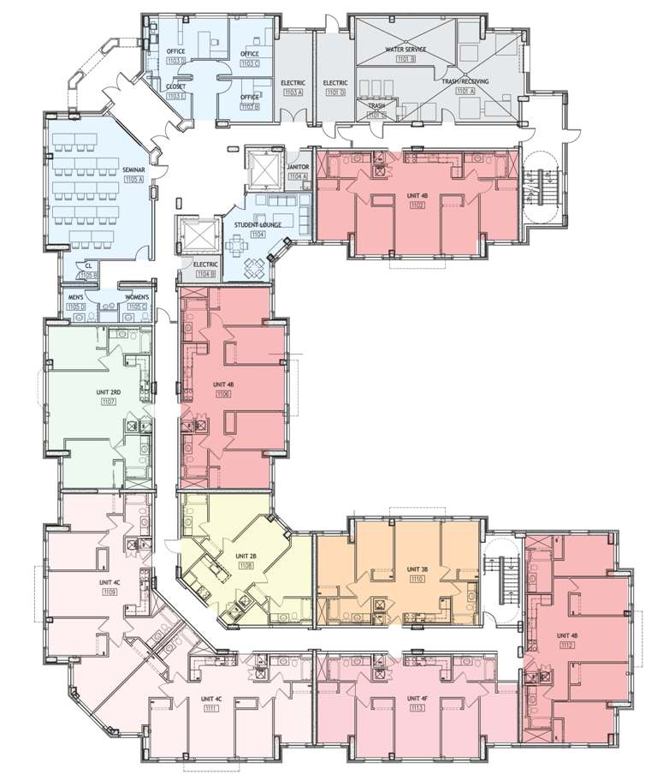
Presentation Outline
Architecture of Building 7
Introduction & Building Overview
    Building Statistics
    Architecture
    Existing Structure Overview
Structural Depth Study
Green Roof Breadth Study
Conclusions & Recommendations
Questions?

Slide 5
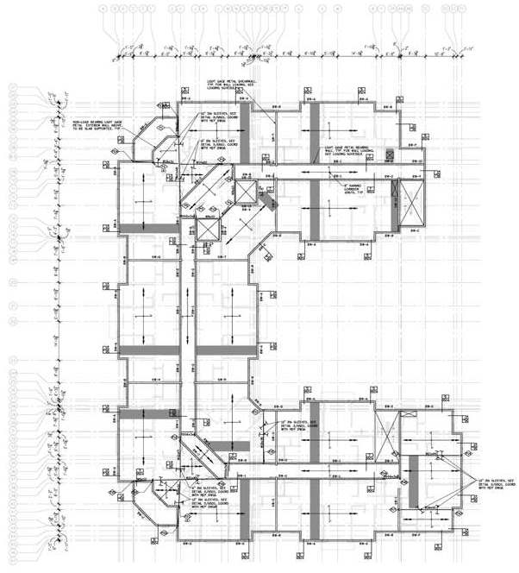
Presentation Outline
Current Existing Structure
Introduction & Building Overview
    Building Statistics
    Architecture
    Existing Structure Overview
Structural Depth Study
Green Roof Breadth Study
Conclusions & Recommendations
Questions?
Perimeter and Corridor Bear walls
  Upper 6 Floors
  16 gage studs at 16-24” OC
  Concrete Columns and Girders
    Lower two Floors
    Beams:
      16-24” deep
      18-36” wide
      Columns
        14” wide
        18-64” deep
Hambro Composite Joists
  3” Conc. slab for upper floors
    16” deep joist in Apt.
    8” deep joist in Corridor
  5” Conc. Slab on lover floors

Slide 6
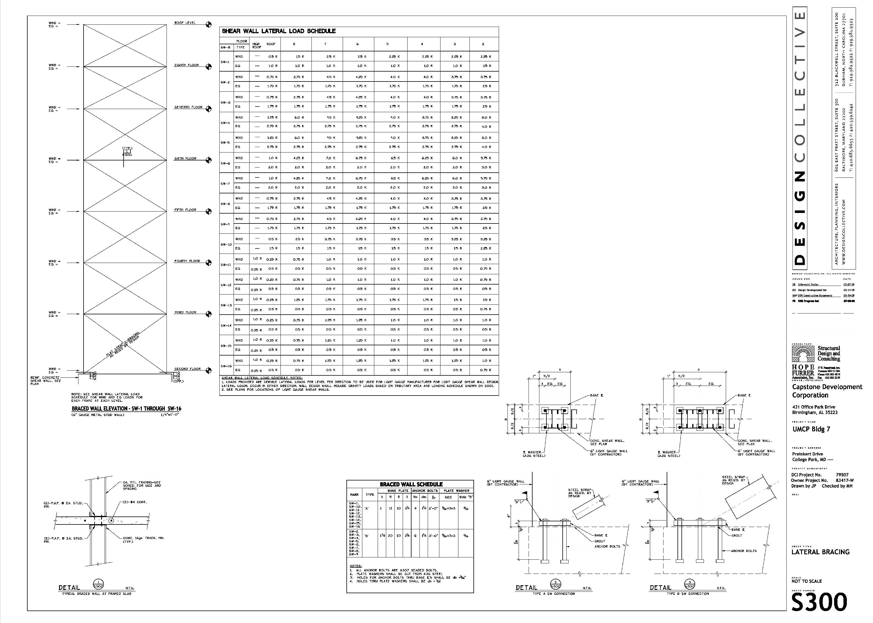
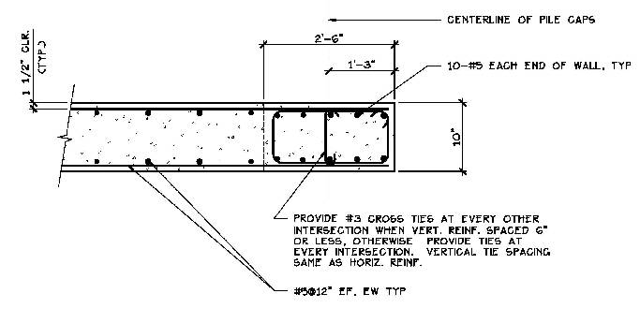
Presentation Outline
Current Existing Structure
Introduction & Building Overview
    Building Statistics
    Architecture
    Existing Structure Overview
    Structural Depth Study
Green Roof Breadth Study
Conclusions & Recommendations
Questions?
Lateral System
  16 Shear walls
    7 in the East-West Direction
    9 in the North-South Direction
  Located between apartments
Concrete Shear walls: Lower 2 floors
  Upper 6 Floors
  16 gage studs at 16-24” OC

Slide 7
Presentation Outline
Thesis Proposal Goals
Introduction & Building Overview
Structural Depth Study
    Thesis Goals
    Design Codes
    Computer Modeling
    Gravity Design
    Gravity Connections
    Lateral Procedure and Loads
    Lateral Design
    Lateral Connections
    Alternatives and Implications
    Foundation Considerations
    Goal Summary
Green Roof Breadth Study
Conclusions & Recommendations
Questions?
Design an overall structure made using structural steel and limit use of propriety systems.
Design a gravity system that does not require a change in the building height while still being acceptable.
Move the location of Building 7 to a high seismic Region to better understand and work with seismic requirements in detail. (San Diego, CA )
Pick a single lateral system that will work for the new location and optimize it.

Slide 8
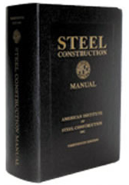


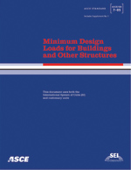
Presentation Outline
Design Standards and Codes
Introduction & Building Overview
Structural Depth Study
    Thesis Goals
    Design Codes
    Computer Modeling
    Gravity Design
    Gravity Connections
    Lateral Procedure and Loads
    Lateral Design
    Lateral Connections
    Alternatives and Implications
    Foundation Considerations
    Goal Summary
Green Roof Breadth Study
Conclusions & Recommendations
Questions?
Steel Design
  AISC Steel Construction Manual, 13th Edition
  AISC Seismic Design Manual (AISC 327-05)
  2005 AISC Seismic Provisions (AISC 341-05)
  AISC Steel Design Guide 19: Fire Resistance of Structural Framing
  Vulcraft Steel Roof and Deck Catalog
Other References
  Minimum Design Loads for Buildings (ASCE 7-05)
  International Building Code 2006

Slide 9
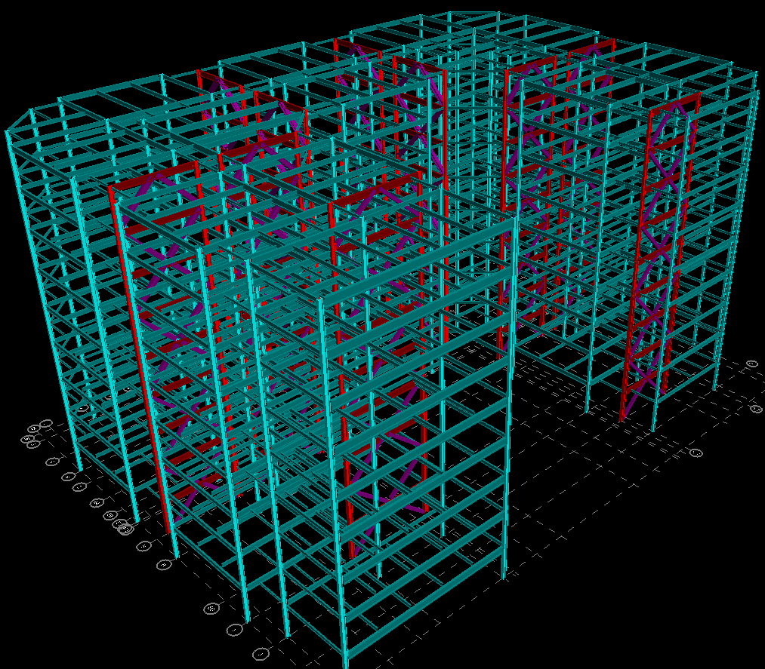
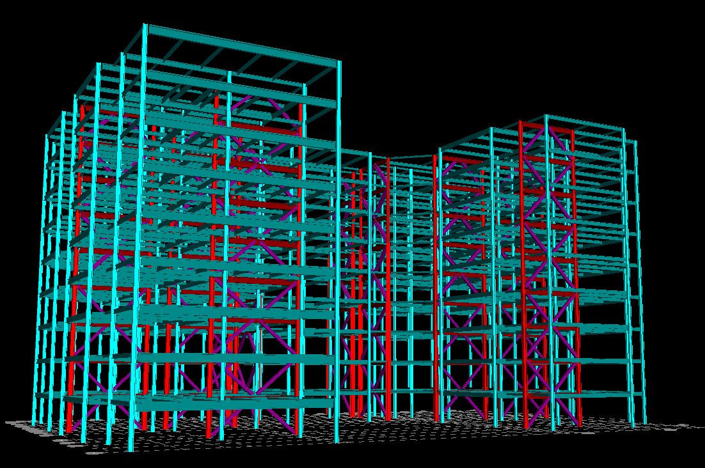
Presentation Outline
RAM Computer Modeling
Introduction & Building Overview
Structural Depth Study
    Thesis Goals
    Design Codes
    Computer Modeling
    Gravity Design
    Gravity Connections
    Lateral Procedure and Loads
    Lateral Design
    Lateral Connections
    Alternatives and Implications
    Foundation Considerations
    Goal Summary
Green Roof Breadth Study
Conclusions & Recommendations
Questions?
Assumptions and Considerations:
  Both Gravity and Lateral Systems were modeled
  Diaphragms assumed to be perfectly rigid
  Columns were modeled with a fixed base to help with drift.
  All proper gravity and lateral load combinations were generated for the model
  P-Delta effects were taken into account according to ASCE 7 -05
  Story shears applied at 5% eccentricity to account for accidental torsion

Slide 10
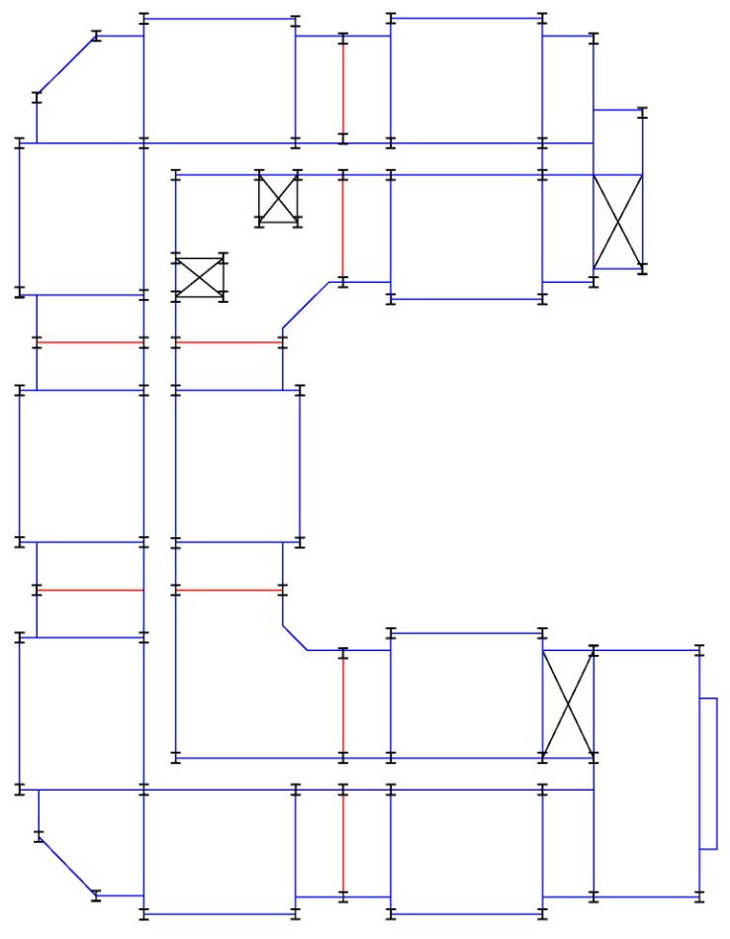
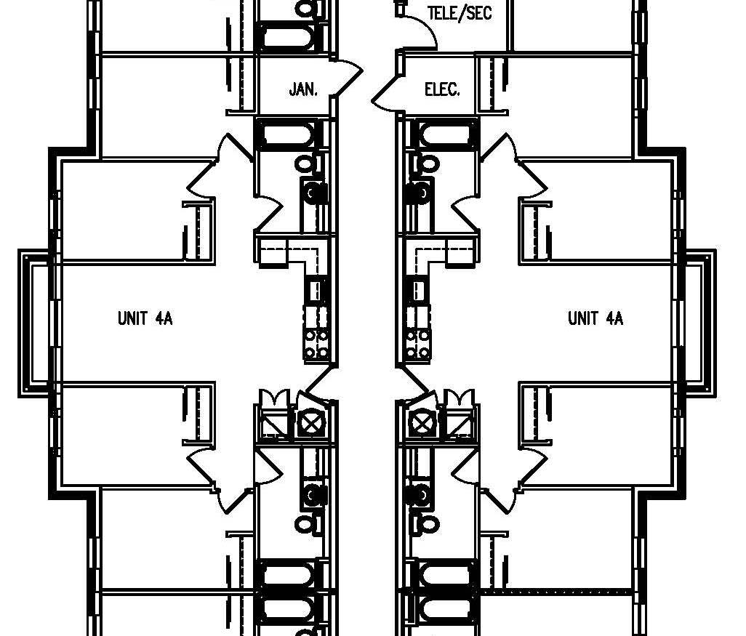
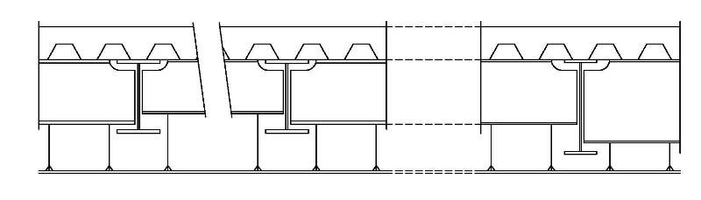
Presentation Outline
Gravity System Design
Introduction & Building Overview
Structural Depth Study
    Thesis Goals
    Design Codes
    Computer Modeling
    Gravity Design
    Gravity Connections
    Lateral Procedure and Loads
    Lateral Design
    Lateral Connections
    Alternatives and Implications
    Foundation Considerations
    Goal Summary
Green Roof Breadth Study
Conclusions & Recommendations
Questions?
Bay Layout Considerations
  Changes in Plan
  Corridor through the center
  Composite vs. Castellated
    Depth of members
    Size of openings for MEP
2 Bays vs. Double-Loaded Corridor
  Depth of members
  Space for MEP
  Quantity of columns

Slide 11
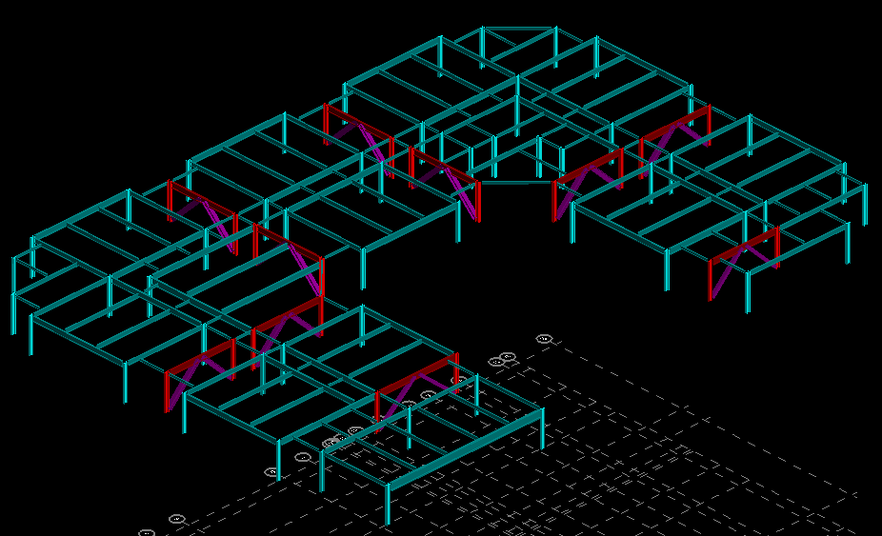
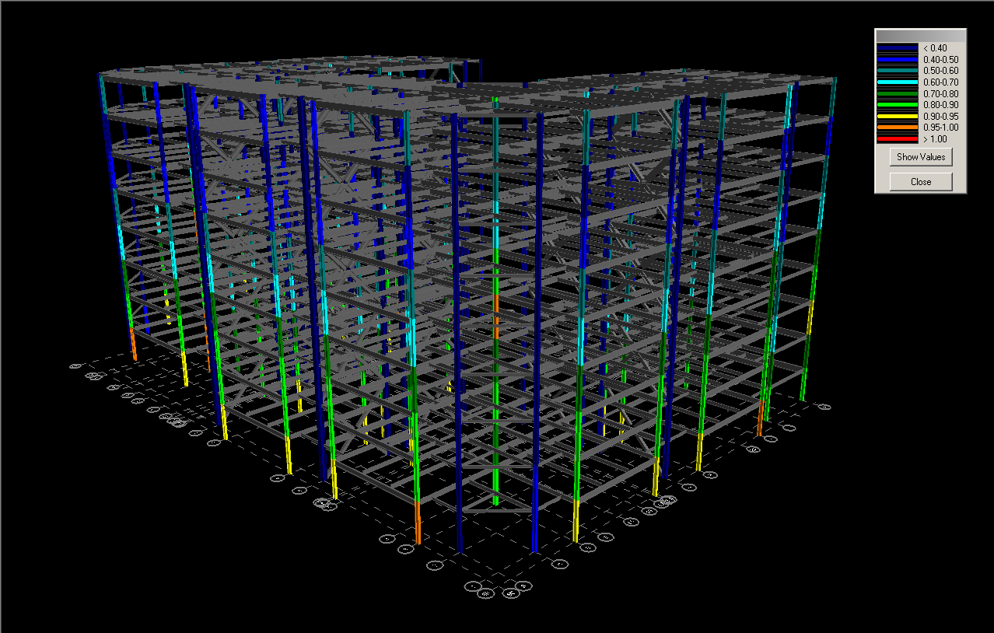
Presentation Outline
Gravity System Design
Introduction & Building Overview
Structural Depth Study
    Thesis Goals
    Design Codes
    Computer Modeling
    Gravity Design
    Gravity Connections
    Lateral Procedure and Loads
    Lateral Design
    Lateral Connections
    Alternatives and Implications
    Foundation Considerations
    Goal Summary
Green Roof Breadth Study
Conclusions & Recommendations
Questions?
Beams and Girders
  Max spacing of 9’-6” typical
  3VL21 composite deck
  Light-weight
  Total slab thickness of 6.25”
  Table 3-19 (composite W-shapes)
Gravity Columns
  Proper live load reduction used
  Spliced every other level
  Limited sizes for repetition
  Table 4-1and Table 6-1

Slide 12
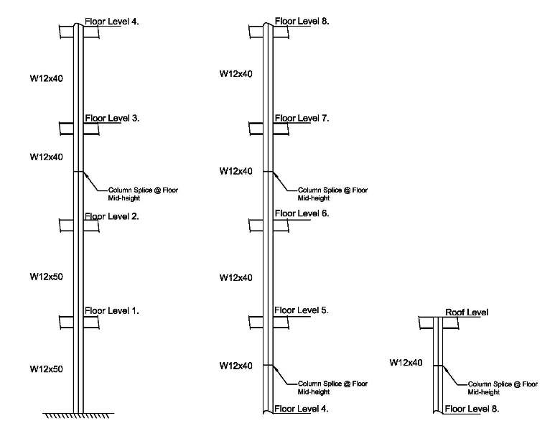
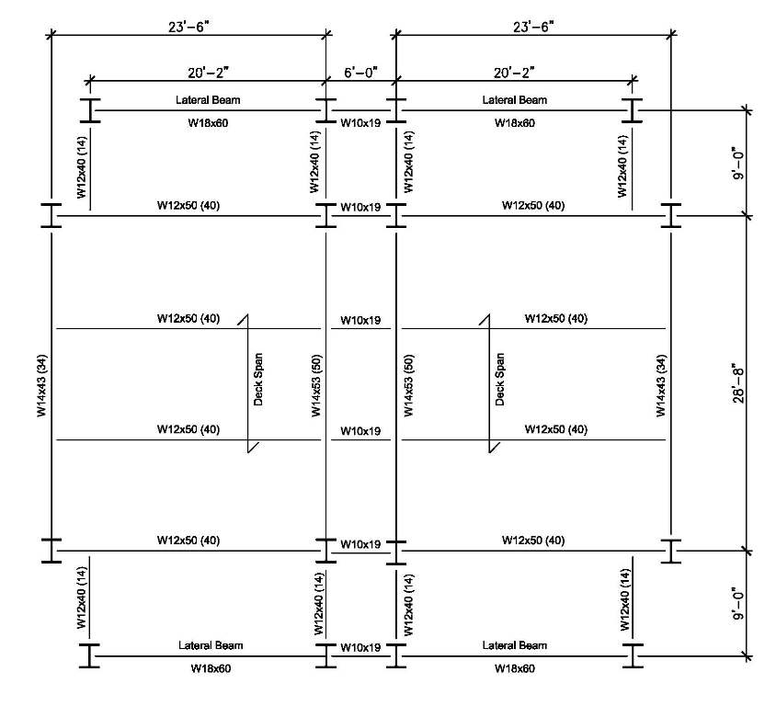
Presentation Outline
Gravity System Design
Introduction & Building Overview
Structural Depth Study
    Thesis Goals
    Design Codes
    Computer Modeling
    Gravity Design
    Gravity Connections
    Lateral Procedure and Loads
    Lateral Design
    Lateral Connections
    Alternatives and Implications
    Foundation Considerations
    Goal Summary
Green Roof Breadth Study
Conclusions & Recommendations
Questions?
Final Typical Bay Design
Final Typical Column Line Design

Slide 13
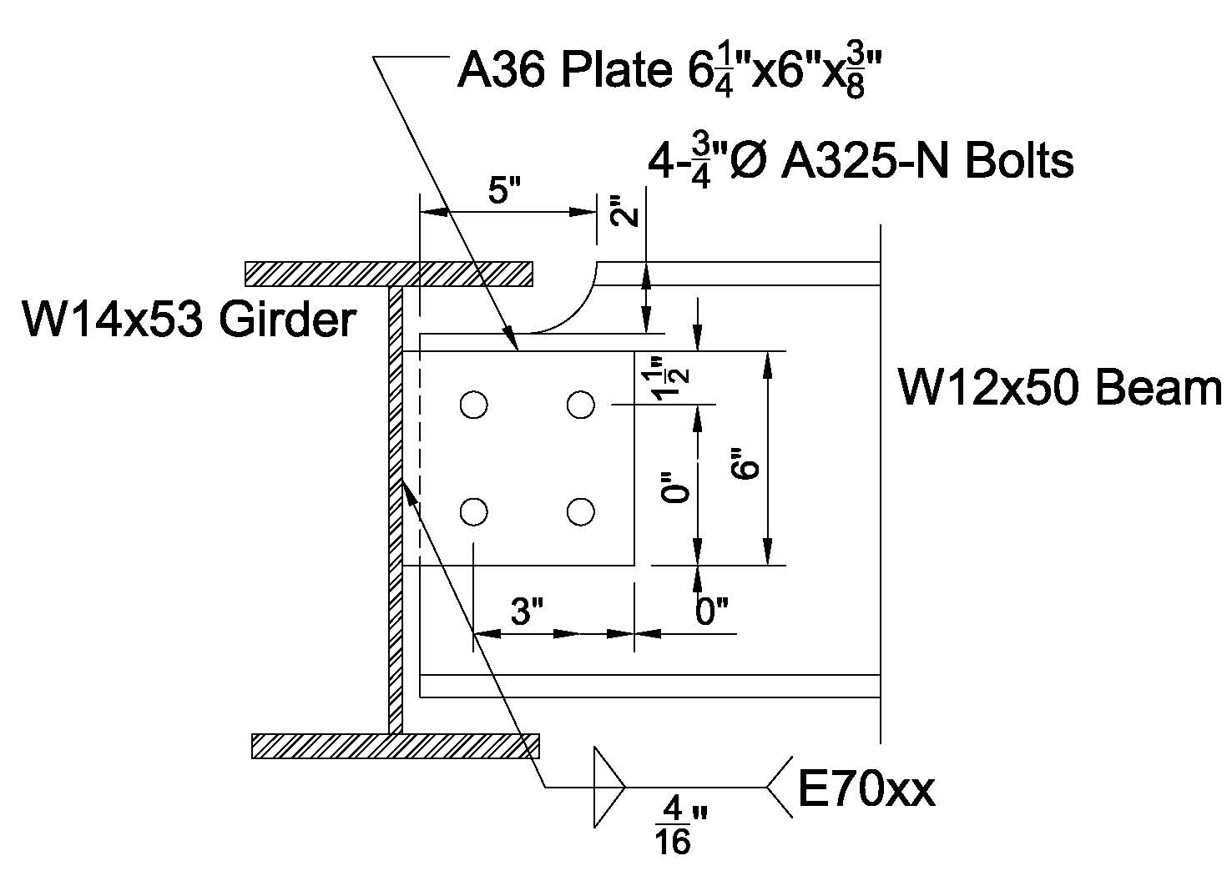
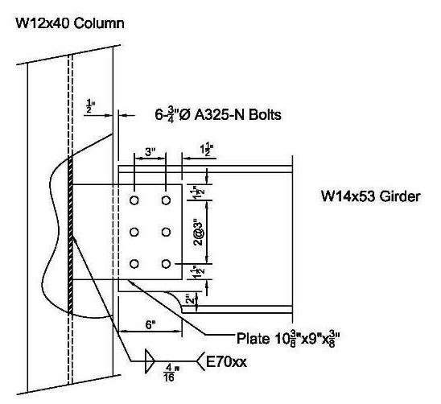
Presentation Outline
Gravity Connections
Introduction & Building Overview
Structural Depth Study
    Thesis Goals
    Design Codes
    Computer Modeling
    Gravity Design
    Gravity Connections
    Lateral Procedure and Loads
    Lateral Design
    Lateral Connections
    Alternatives and Implications
    Foundation Considerations
    Goal Summary
Green Roof Breadth Study
Conclusions & Recommendations
Questions?
Beam to Girder Connection :
Shear Tab design
Single Top Cope Beam
Bolted to the beam and welded to the
Girder to Column Connection :
Extended shear tab design
Cope at the bottom for placing concerns
Bolted to the girder and welded to the column

Slide 14
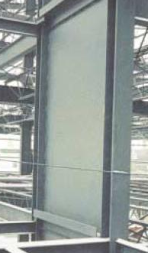
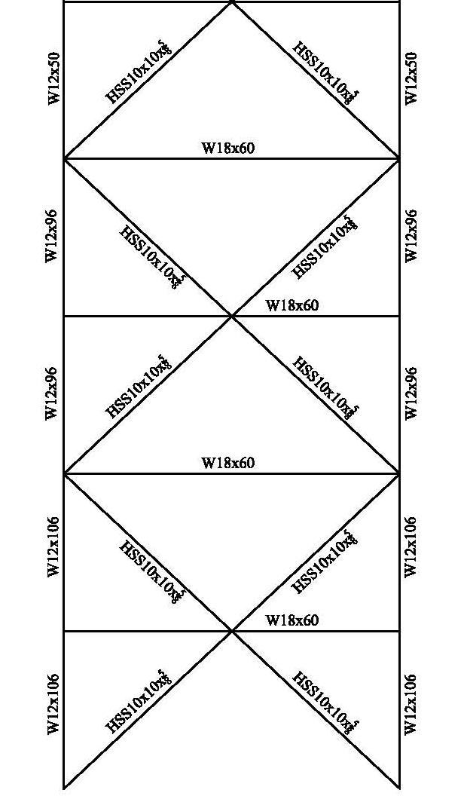
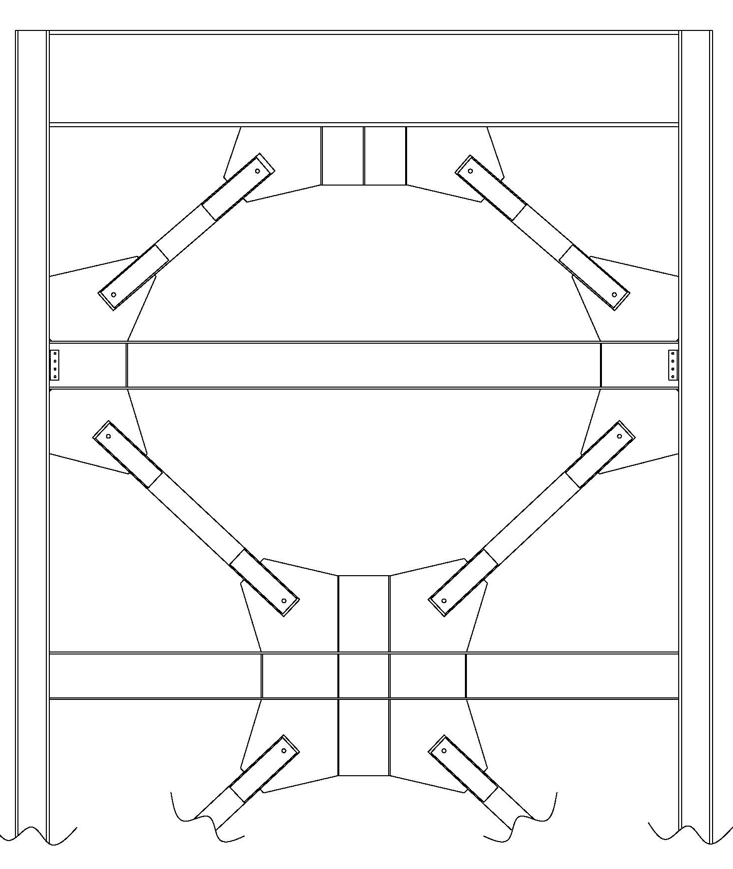
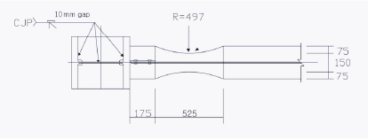
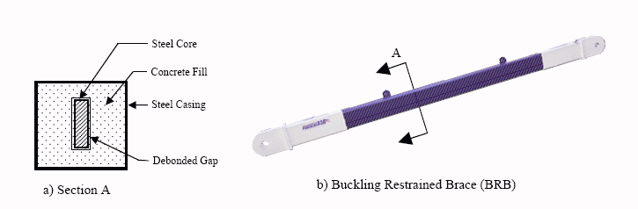
Presentation Outline
Possible Lateral Systems
Introduction & Building Overview
Structural Depth Study
    Thesis Goals
    Design Codes
    Computer Modeling
    Gravity Design
    Gravity Connections
    Lateral Procedure and Loads
    Lateral Design
    Lateral Connections
    Alternatives and Implications
    Foundation Considerations
    Goal Summary
Green Roof Breadth Study
Conclusions & Recommendations
Questions?
Considered Viable Lateral Systems
  Special Concentric Braced Frames
  Special Moment Frames
  Special Plate Shear walls
  Buckling Restrained Braced Frames
Chosen Lateral System: SCBF
  Reasons
    Most commonly used
    Initial available space for them
    Multiple bracing configurations
    No specialty software required
    Many connection options

Slide 15
Presentation Outline
Acceptable Lateral Procedure
Introduction & Building Overview
Structural Depth Study
    Thesis Goals
    Design Codes
    Computer Modeling
    Gravity Design
    Gravity Connections
    Lateral Procedure and Loads
    Lateral Design
    Lateral Connections
    Alternatives and Implications
    Foundation Considerations
    Goal Summary
Green Roof Breadth Study
Conclusions & Recommendations
Questions?
Checks:
Horizontal Irregularity Check
Vertical irregularity Check
With SDC D
  Equivalent Lateral Force Procedure is Acceptable
Vertical Structural Irregularities
Type | Irregularity | Comment | Status
1a | Stiffness-Soft Story | Members are larger going down the building, plus calculations were done to prove it in a later section. | Good
2 | Weight (Mass) | Was carefully looked at due to the green roof and Mechanical Units but roof was approx. 400 kips under limit. | Good
3 | Vertical Geometric | Plans show same geometry the height of the building. | Good
4 | In‐Plane Discontinuity of Vertical Lateral Force Resisting Element | No discontinuity exists by inspection of the drawings. | Good
5a, b | Discontinuity in Lateral Strength | Members are upsized going down the building resulting in a higher strength. | Good
Horizontal Structural Irregularities
Type | Irregularity | Comment | Status
1a | Torsional | After Modeling structure it can been concluded that this irregularity does not exist. | Good
2 | Reentrant Corner | This irregularity does exist due to the U-Shape of the plans but ELFP is allowed, a 25% force increase for the connections between the diaphragm and the vertical elements are required. | Not Met
3 | Diaphragm Discontinuity | Irregularity does not exist by inspection of the drawings. | Good
4 | Out of Plane Offsets | No vertical element out of plane offsets exists by inspection of the drawing. | Good
5 | Non Parallel System | All lateral force resisting systems are parallel to the orthogonal axes. | Good

Slide 16
Presentation Outline
Seismic Loads
Introduction & Building Overview
Structural Depth Study
    Thesis Goals
    Design Codes
    Computer Modeling
    Gravity Design
    Gravity Connections
    Lateral Procedure and Loads
    Lateral Design
    Lateral Connections
    Alternatives and Implications
    Foundation Considerations
    Goal Summary
Green Roof Breadth Study
Conclusions & Recommendations
Questions?
Criteria:
SDC D
R=6
I=1.0
Building Periods
Tx = 0.907 seconds
Ty = 0.732 seconds
Vertical Force Distribution E-W Direction
Floor | Height (Ft.) | Weight (Kips) | Cvx | Fx (kips) | Story Shear
Roof | 90 | 2145.00 | 0.24 | 398.08 | 398.08
8 | 80 | 1700.00 | 0.17 | 280.44 | 678.52
7 | 70 | 1700.00 | 0.15 | 245.39 | 923.91
6 | 60 | 1700.00 | 0.13 | 210.33 | 1134.24
5 | 50 | 1700.00 | 0.11 | 175.28 | 1309.51
4 | 40 | 1700.00 | 0.08 | 140.22 | 1449.73
3 | 30 | 1700.00 | 0.06 | 105.17 | 1554.90
2 | 20 | 1700.00 | 0.04 | 70.11 | 1625.01
1 | 10 | 1700.00 | 0.02 | 35.06 | 1660.06
Total Weight |  | 15745 | kips
Seismic Base Shear |  | 1660.06 | kips
Overturning Moment |  | 107,339.65 | kip-ft
Vertical Force Distribution N-S Direction
floor | Height (Ft.) | Weight (Kips) | Cvx | Fx (kips) | Story Shear
Roof | 90 | 2145.00 | 0.24 | 467.42 | 467.42
8 | 80 | 1700.00 | 0.17 | 329.29 | 796.70
7 | 70 | 1700.00 | 0.15 | 288.12 | 1084.83
6 | 60 | 1700.00 | 0.13 | 246.96 | 1331.79
5 | 50 | 1700.00 | 0.11 | 205.80 | 1537.59
4 | 40 | 1700.00 | 0.08 | 164.64 | 1702.24
3 | 30 | 1700.00 | 0.06 | 123.48 | 1825.72
2 | 20 | 1700.00 | 0.04 | 82.32 | 1908.04
1 | 10 | 1700.00 | 0.02 | 41.16 | 1949.20
Total Weight |  | 15745 | kips
Seismic Base Shear |  | 1949.20 | kips
Overturning Moment |  | 126,035.22 | kip-ft

Slide 17
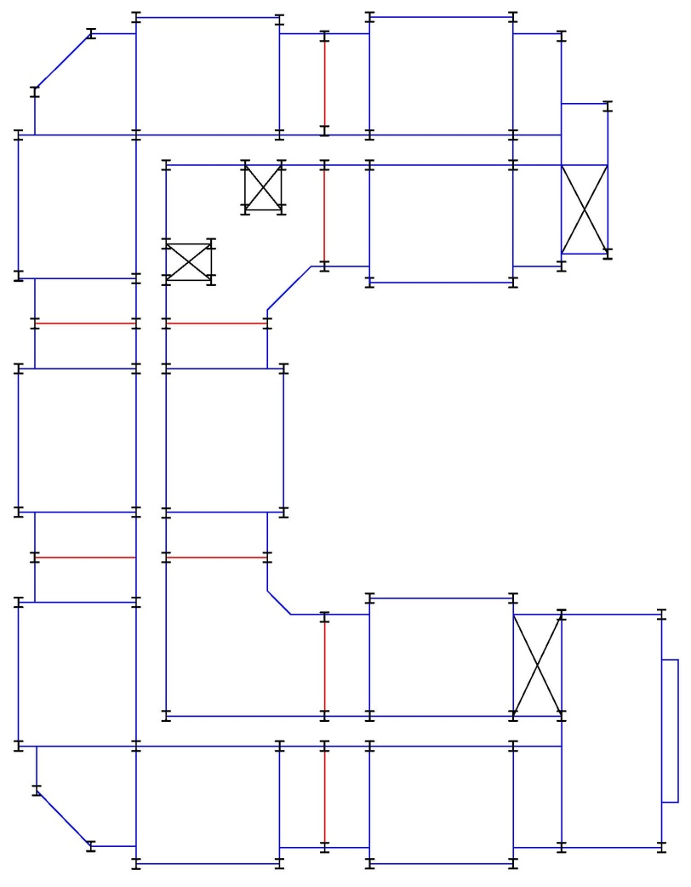
Presentation Outline
Lateral System Design
Introduction & Building Overview
Structural Depth Study
    Thesis Goals
    Design Codes
    Computer Modeling
    Gravity Design
    Gravity Connections
    Lateral Procedure and Loads
    Lateral Design
    Lateral Connections
    Alternatives and Implications
    Foundation Considerations
    Goal Summary
Green Roof Breadth Study
Conclusions & Recommendations
Questions?
Location of SCBF
  Limited to within walls due to braces
  No perimeter frames
  Original locations the best solution
Quantity in each Direction
  Reduced the number from existing
  4 in the East-West Direction
  6 in the North-South Direction

Slide 18
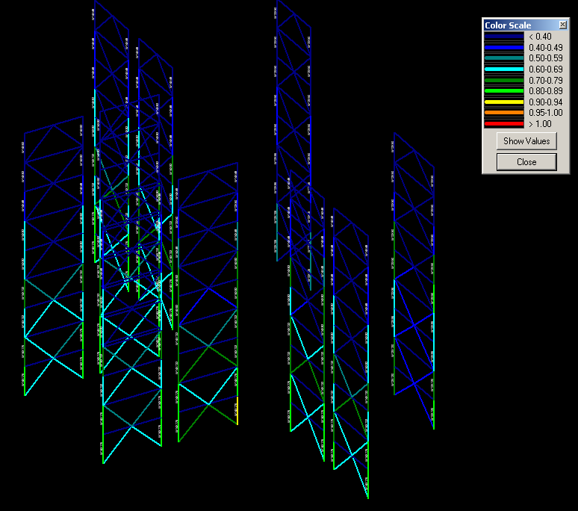
Presentation Outline
Lateral System Design
Introduction & Building Overview
Structural Depth Study
    Thesis Goals
    Design Codes
    Computer Modeling
    Gravity Design
    Gravity Connections
    Lateral Procedure and Loads
    Lateral Design
    Lateral Connections
    Alternatives and Implications
    Foundation Considerations
    Goal Summary
Green Roof Breadth Study
Conclusions & Recommendations
Questions?
Key Load Combinations
1.2D + 1.6W + L + 0.5(Lr or S or R)
(1.2 + 0.2SDS)D + ρQE + L + 0.2S
(0.9 − 0.2SDS)D + ρQE + 1.6H
Adjusting Members
  Increase brace sizes
  Increase column sizes
  Increase beam sizes
Member Design
  Lower stories controlled by strength
    60-75%capacity of members
  Upper Stories controlled by drift
    15-20% capacity of members

Slide 19
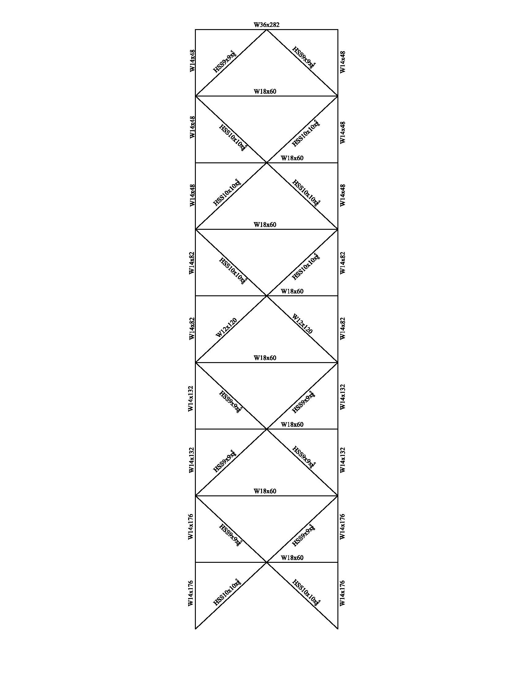
Presentation Outline
Lateral System Design
Introduction & Building Overview
Structural Depth Study
    Thesis Goals
    Design Codes
    Computer Modeling
    Gravity Design
    Gravity Connections
    Lateral Procedure and Loads
    Lateral Design
    Lateral Connections
    Alternatives and Implications
    Foundation Considerations
    Goal Summary
Green Roof Breadth Study
Conclusions & Recommendations
Questions?
Typical SCBF Design

Slide 20
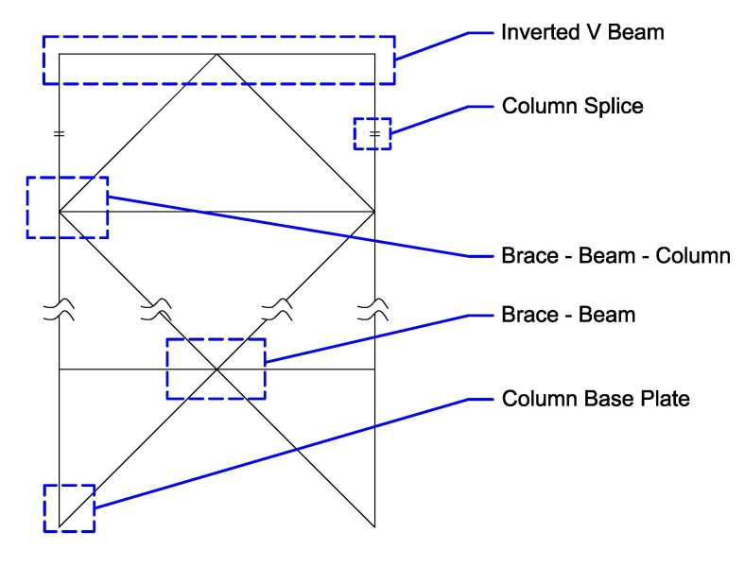
Presentation Outline
Lateral Connections & Detailing
Introduction & Building Overview
Structural Depth Study
    Thesis Goals
    Design Codes
    Computer Modeling
    Gravity Design
    Gravity Connections
    Lateral Procedure and Loads
    Lateral Design
    Lateral Connections
    Alternatives and Implications
    Foundation Considerations
    Goal Summary
Green Roof Breadth Study
Conclusions & Recommendations
Questions?
Typical Lateral Connections
  5 Standard/critical connections
  Designed per AISC 341-05
  Loads determined by ASCE 7-05

Slide 21
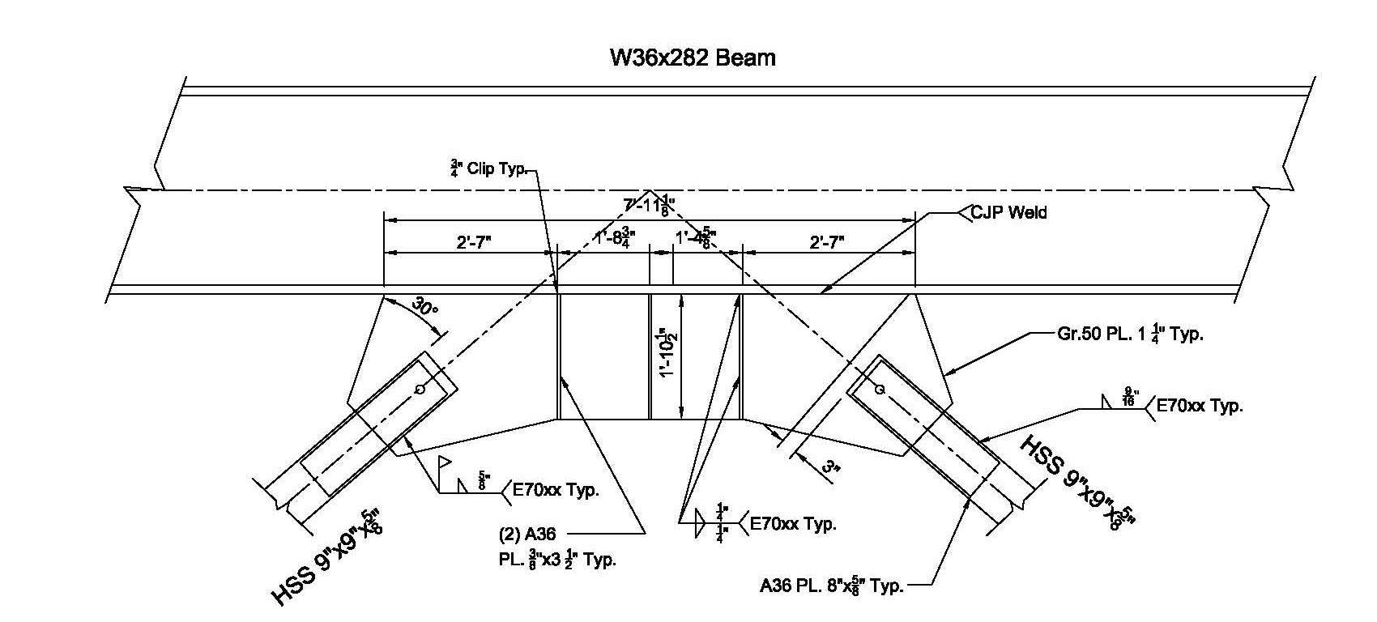
Presentation Outline
Lateral Connections & Detailing
Introduction & Building Overview
Structural Depth Study
    Thesis Goals
    Design Codes
    Computer Modeling
    Gravity Design
    Gravity Connections
    Lateral Procedure and Loads
    Lateral Design
    Lateral Connections
    Alternatives and Implications
    Foundation Considerations
    Goal Summary
Green Roof Breadth Study
Conclusions & Recommendations
Questions?
Inverted-V Design
  Beam takes unbalanced Load
  Gusset plate requires Stiffeners
  Gusset plate attached at the shop
  Reinforced HSS brace at ends
  Yield line on gusset plate

Slide 22
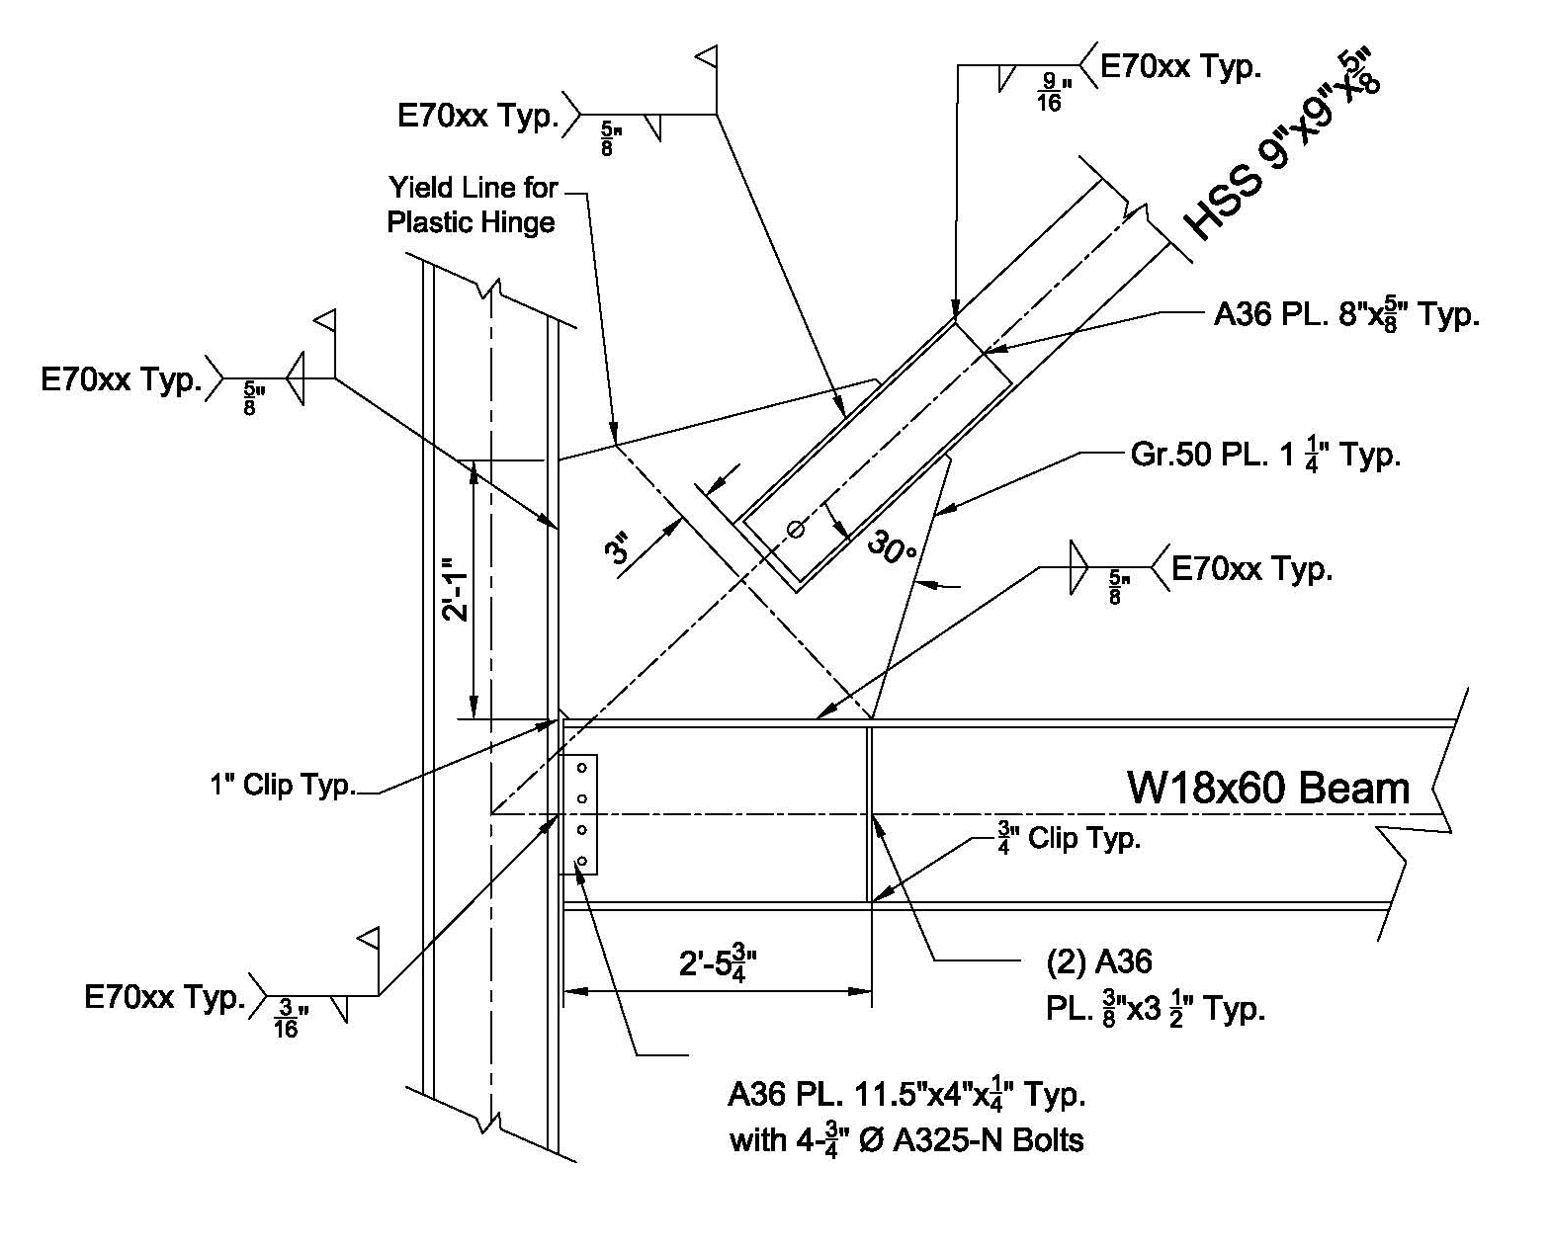
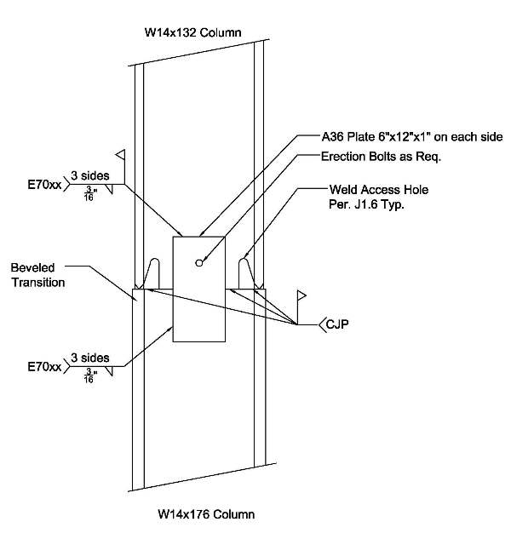
Presentation Outline
Lateral Detailing
Column Splice Design
  CJP Weld for full strength
  Weld access holes per Spec. J1.6
  Plate for shear capacity requirement
  Designed not to yield or form a story mechanism
Introduction & Building Overview
Structural Depth Study
    Thesis Goals
    Design Codes
    Computer Modeling
    Gravity Design
    Gravity Connections
    Lateral Procedure and Loads
    Lateral Design
    Lateral Connections
    Alternatives and Implications
    Foundation Considerations
    Goal Summary
Green Roof Breadth Study
Conclusions & Recommendations
Questions?
Brace to Beam & Column Design
  Uniform method to eliminate moments
  Reinforced HSS at ends for capacity
  Shear tab for beam to column
  All welded connection except beam shear tab
  Yield line on gusset plate

Slide 23
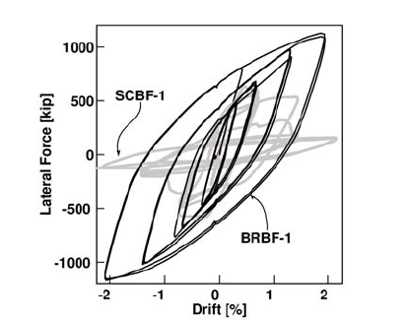
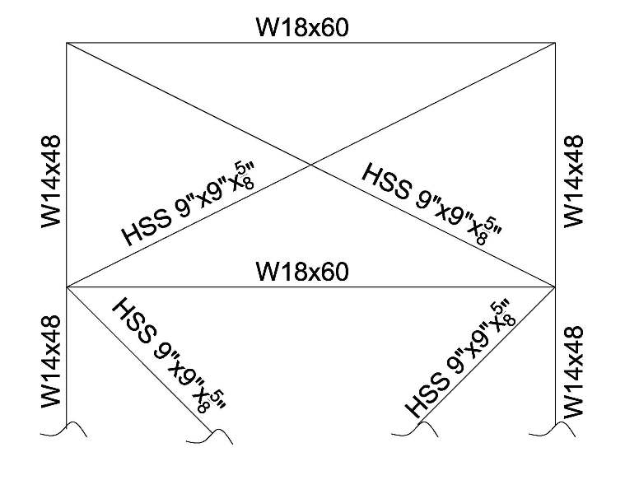
Presentation Outline
Alternative Structural Options
Introduction & Building Overview
Structural Depth Study
    Thesis Goals
    Design Codes
    Computer Modeling
    Gravity Design
    Gravity Connections
    Lateral Procedure and Loads
    Lateral Design
    Lateral Connections
    Alternatives and Implications
    Foundation Considerations
    Goal Summary
Green Roof Breadth Study
Conclusions & Recommendations
Questions?
Two Alternatives Considered:
Alternate top single story X for frames
Use of Buckling Restrained Braced Frames
Alternate Top Story
Eliminates the inverted-V and decreases the beam size to W18x60
Braces became slightly smaller
Helps with the drift
Buckling Restrained brace Frames
Slight improvement at drift control
Smaller connections
Can act as true pined-pined member
More costly but less non-structural damage during an earthquake

Slide 24
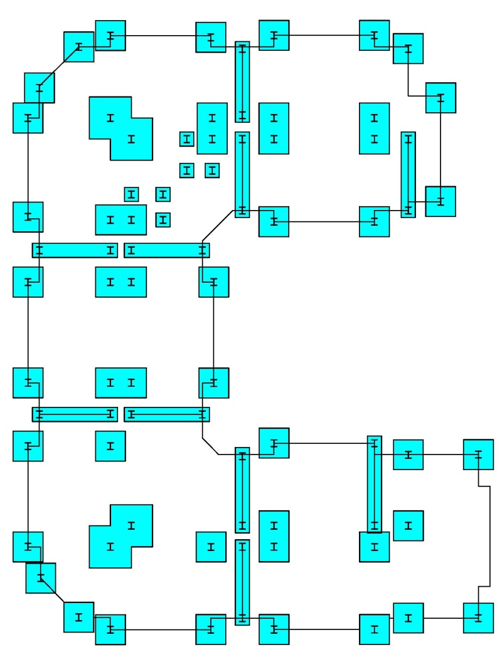
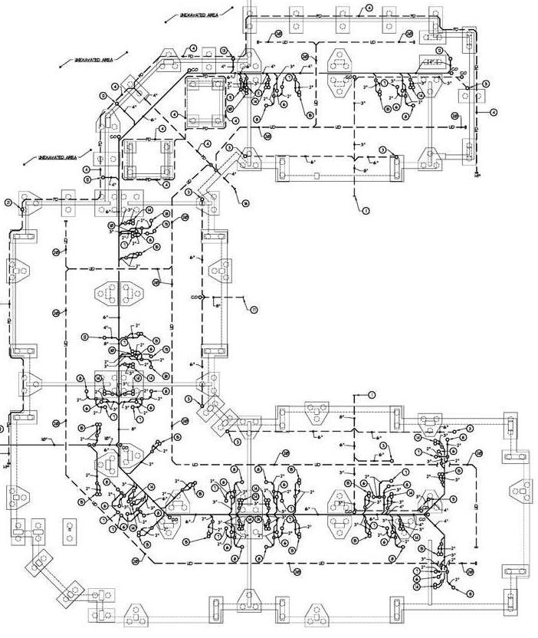
Presentation Outline
Foundation Considerations
Introduction & Building Overview
Structural Depth Study
    Thesis Goals
    Design Codes
    Computer Modeling
    Gravity Design
    Gravity Connections
    Lateral Procedure and Loads
    Lateral Design
    Lateral Connections
    Alternatives and Implications
    Foundation Considerations
    Goal Summary
Green Roof Breadth Study
Conclusions & Recommendations
Questions?
Implications
Change in structural system
  Different layout from the original
Change in location
  Soil interaction during and Earthquake
  Foundation ties
  Dynamic ground movement and stresses
  Energy dissipation
 | Load (Kips) | Soil Bearing (ksf) | Area needed (sf) | Sizes (ft.)
Typical Exterior Column | 355.00 | 5.56 | 63.90 | 8
Typical Interior Column | 324.00 | 5.56 | 58.32 | 8
Corridor bend Column | 600.00 | 5.56 | 108.00 | 10

Slide 25
Presentation Outline
Structural Goal Summary
Introduction & Building Overview
Structural Depth Study
    Thesis Goals
    Design Codes
    Computer Modeling
    Gravity Design
    Gravity Connections
    Lateral Procedure and Loads
    Lateral Design
    Lateral Connections
    Alternatives and Implications
    Foundation Considerations
    Goal Summary
Green Roof Breadth Study
Conclusions & Recommendations
Questions?
1.) Design an overall structure made using structural steel and limit use of propriety systems.
Outcome: The new steel design achieves this very well. (4.5/5)
2.) Design a gravity system that does not require a change in the building height while still being acceptable.
  Outcome: The design follows this but has limitations/issues (3/5)
3.) Move the location of Building 7 to a high seismic Region to better understand and work with seismic requirements in detail. (San Diego, CA )
Outcome: The move allowed for a more challenging design (5/5)
4.) Pick a single lateral system that will work for the new location and optimize it.
    Outcome: The system works but has issues with the code (3.5/5)

Slide 26
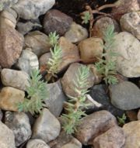
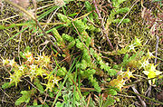
Presentation Outline
Green Roof Study
Introduction & Building Overview
Structural Depth Study
Green Roof Breadth Study
    Material and Considerations
    Green Roof Layout and Design
    Water Collection System Design
    LEED and Impacts
    Green Roof Summary
Conclusions & Recommendations
Questions?
Reasons for a Green Roof
Original Building 7 did not have one due to cost concerns
They can reduce the heat island effect and the use of excess gray water
Chosen Roof Type
Extensive Green Roof
  Very self –sustaining
  Minimum yearly maintenance
  Lighter and for non-accessible roofs
Plant types
Wanted a low maintenance and acceptable in both locations
  Sedum species along with mosses
  Readily available in both locations

Slide 27
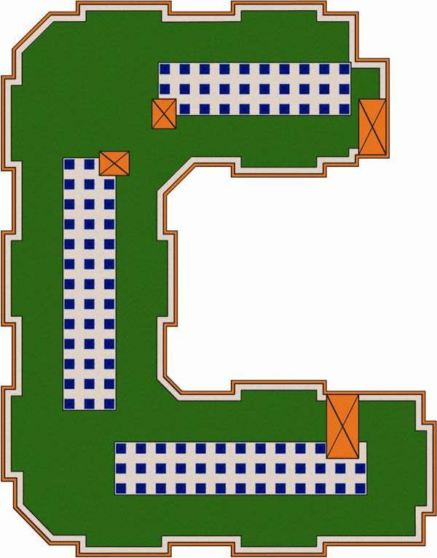
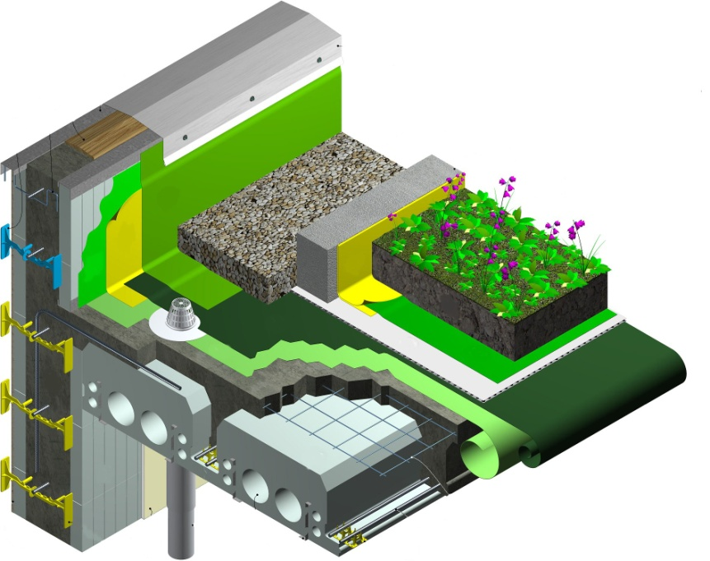
Presentation Outline
Green Roof Layout
Introduction & Building Overview
Structural Depth Study
Green Roof Breadth Study
    Material and Considerations
    Green Roof Layout and Design
    Water Collection System Design
    LEED and Impacts
    Green Roof Summary
Conclusions & Recommendations
Questions?
Layout
Mechanical units moved to 3 locations
1’ Gravel around the perimeter
Gravel around the mechanical units
Details
2 layers of rubber membrane for water
Filtering mesh for water runoff
3” soil for the plant life

Slide 28
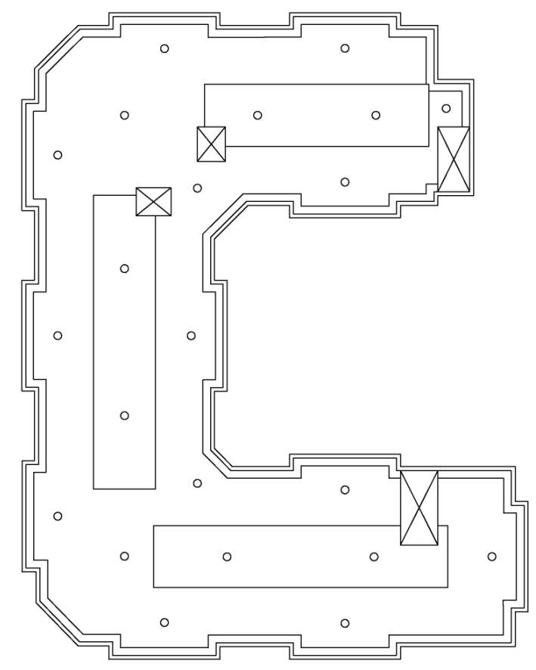
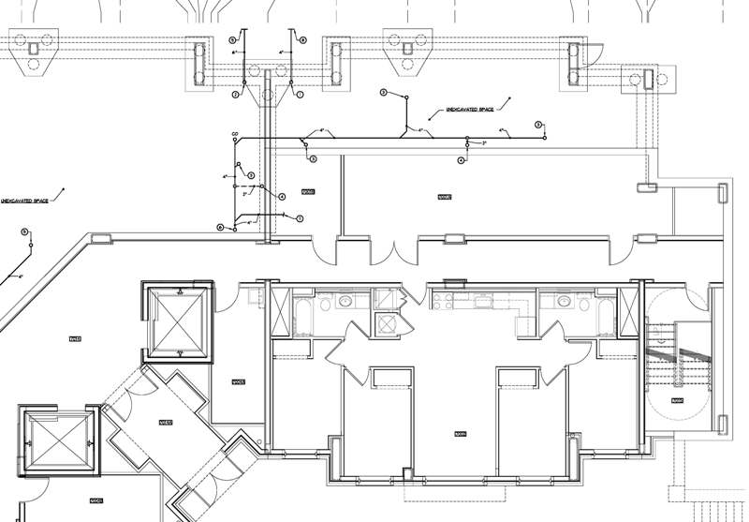
Presentation Outline
Water Collection System
Tank and Room Design
Room was located on the ground level
Tanks sized with average annual rainfall from (NOAA)
  College park = 44” per yr.
  San Diego = 5” per yr.
Tank sizes:
  College park = 2-1000 Gallon Tanks
  San Diego = 1-500 Gallon Tank
Introduction & Building Overview
Structural Depth Study
Green Roof Breadth Study
    Material and Considerations
    Green Roof Layout and Design
    Water Collection System Design
    LEED and Impacts
    Green Roof Summary
Conclusions & Recommendations
Questions?
Drain Design
Based on rain accumulating during a storm
Two drain sizes:
  6” drains on the main body of the roof
  3” drains along the perimeter

Slide 29

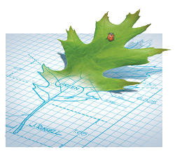
Presentation Outline
LEED Considerations
Introduction & Building Overview
Structural Depth Study
Green Roof Breadth Study
    Material and Considerations
    Green Roof Layout and Design
    Water Collection System Design
    LEED and Impacts
    Green Roof Summary
Conclusions & Recommendations
Questions?
Initial LEED Goals and Design
Become a minimum of LEED certified
  Currently 1 Point away from LEED Gold
  Residents need to take a class on how to keep the building more efficient and green
Points Gained by The Green Roof
Reduction in the heat island effect
  Gain = 1 Point
The increase usage of gray water to reduce the building’s consumption
  Gain = 1 Point
Other Green Advantages from the Design
The usage of structural steel
  Consists mostly of recycled scrap steel

Slide 30
Presentation Outline
Green Roof Summary
Introduction & Building Overview
Structural Depth Study
Green Roof Breadth Study
    Material and Considerations
    Green Roof Layout and Design
    Water Collection System Design
    LEED and Impacts
    Green Roof Summary
Conclusions & Recommendations
Questions?
1.) The green roof was designed for both locations and is acceptable for both
Outcome: (4/5)
2.) The water collection system is acceptable for both locations but is greener for College Park MD
  Outcome: (5/5)
3.) The redesign reduces in the impact on the environment and also bring the LEED rating to Gold.
Outcome: (5/5)

Slide 31
Presentation Outline
Conclusions & Recommendations
Introduction & Building Overview
Structural Depth Study
Green Roof Breadth Study
Conclusions & Recommendations
Questions?
1.) The structural system meets the redesign goals for both gravity and lateral systems and is a good choice for a high seismic region
  Recommendations:
    Implement the alternative structural alternatives
    Use a modal analysis procedure so to obtain a base shear reduction
    Use expansion joints to separate the U-shape into 3 buildings
2.) The green roof and water collection system reduces in the impact on the environment and also bring the LEED rating to Gold.

Slide 32
Presentation Outline
Acknowledgements
Introduction & Building Overview
Structural Depth Study
Green Roof Breadth Study
Conclusions & Recommendations
Questions?
University of Maryland College Park
Design Collective
Burdette, Koehler, Murphy & Associates
Hope Furrer Associates Inc.
Hope Furrer
Melissa Harmon
The Pennsylvania State University
Dr. Ali Memari
Dr. Andres Lepage
Professor M. Kevin Parfitt
The entire AE faculty and staff
A special thanks to my family and friends who have all provided me with guidance and support these past years.

Slide 33
Presentation Outline
Introduction & Building Overview
Structural Depth Study
Green Roof Breadth Study
    Material and Considerations
    Green Roof Layout and Design
    Water Collection System Design
    LEED and Impacts
    Green Roof Summary
Conclusions & Recommendations
Questions?
Questions?

Slide 34
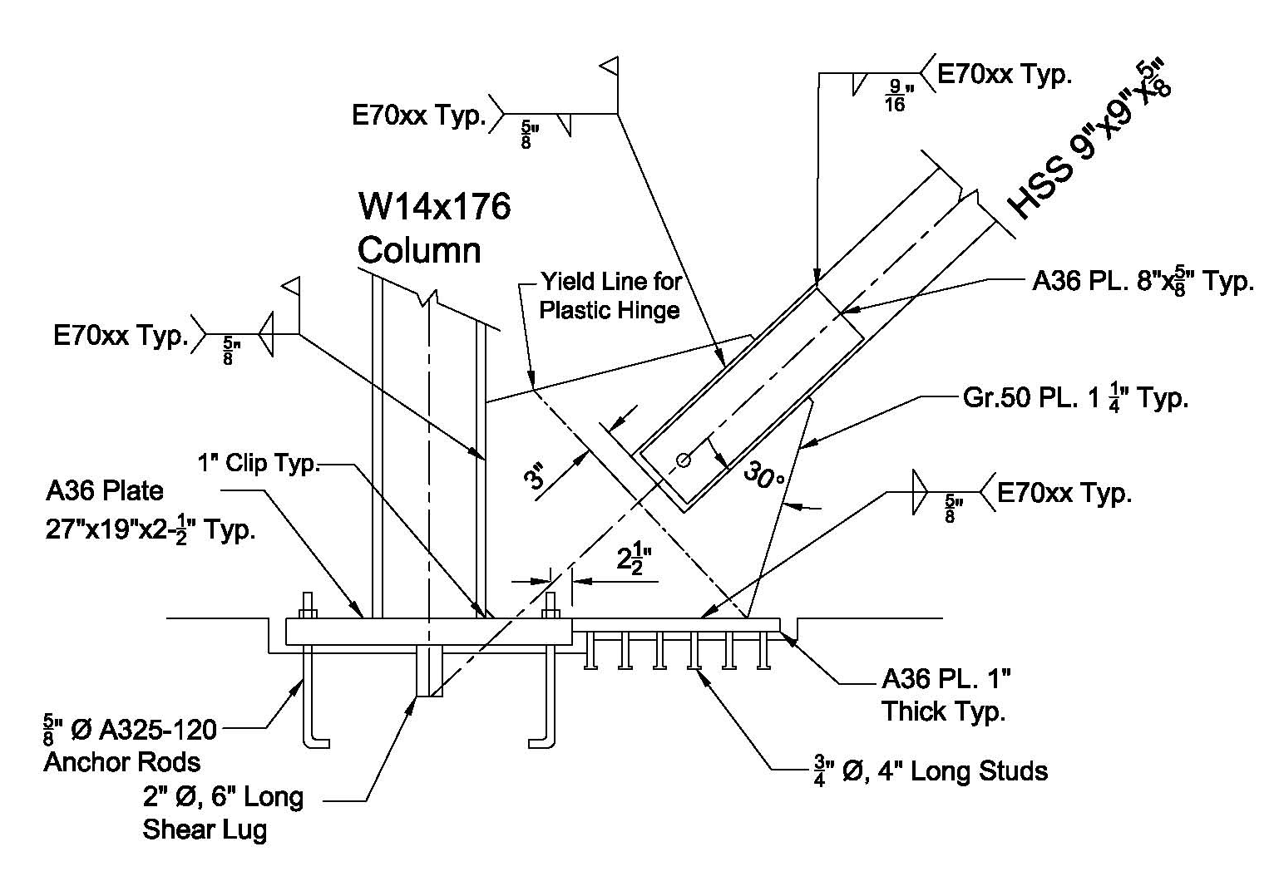
Presentation Outline
Lateral Detailing
Introduction & Building Overview
Structural Depth Study
    Thesis Goals
    Design Codes
    Computer Modeling
    Gravity Design
    Gravity Connections
    Lateral Procedure and Loads
    Lateral Design
    Lateral Connections
    Alternatives and Implications
    Foundation Considerations
    Goal Summary
Green Roof Breadth Study
Conclusions & Recommendations
Questions?
Brace & Column to Base Plate Design
  Uniform method to eliminate moments
  Anchors around the perimeter to generate a large inertia
  Shear Lug to transfer shear
  Recessed base plate in foundation for flat surface for architecture

Slide 35
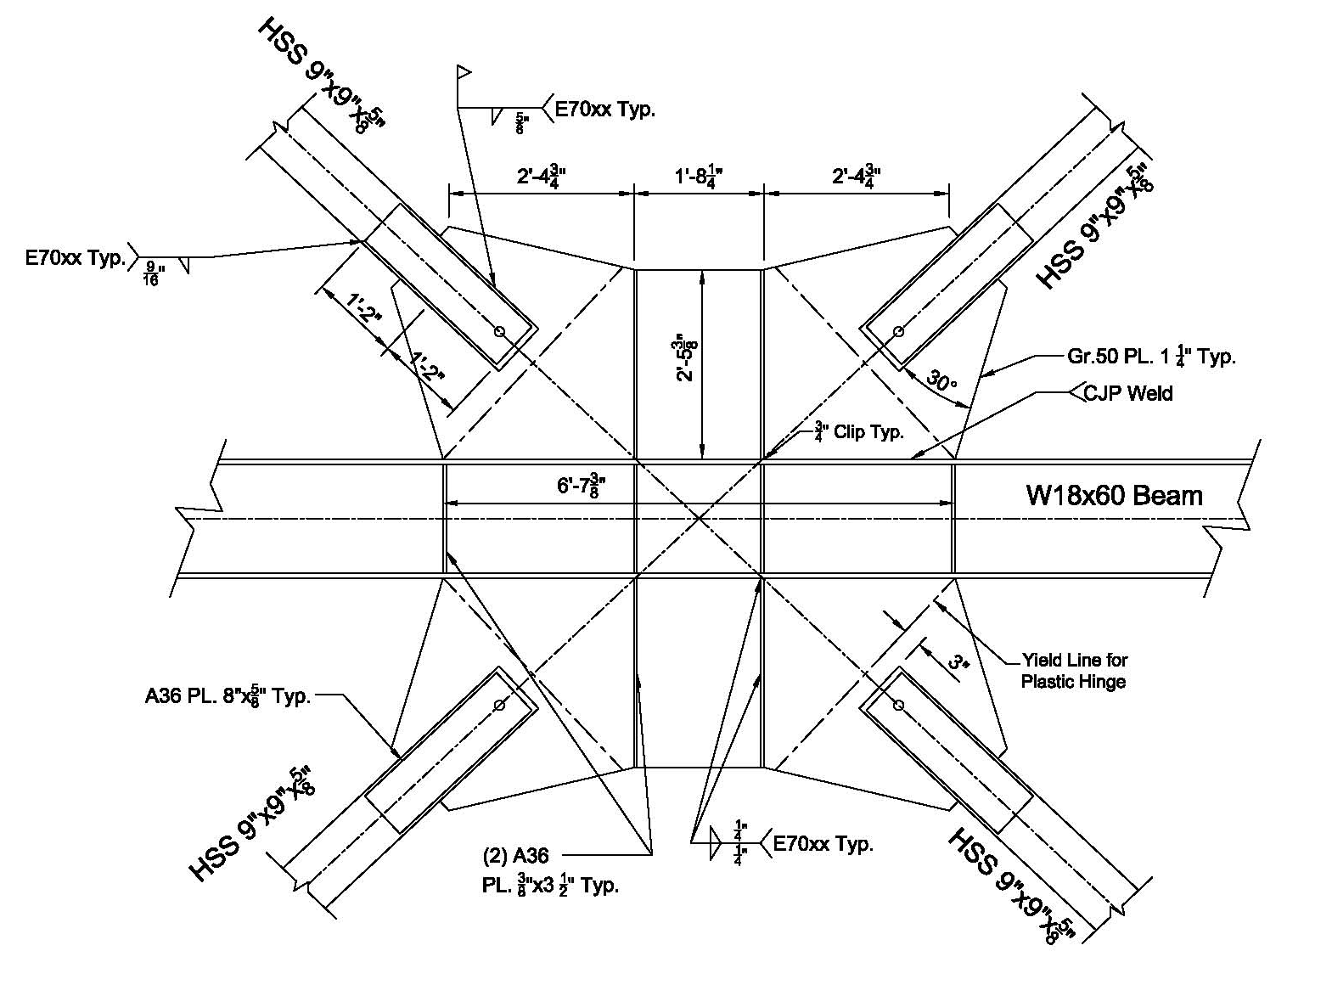
Presentation Outline
Lateral Connections & Detailing
Introduction & Building Overview
Structural Depth Study
    Thesis Goals
    Design Codes
    Computer Modeling
    Gravity Design
    Gravity Connections
    Lateral Procedure and Loads
    Lateral Design
    Lateral Connections
    Alternatives and Implications
    Foundation Considerations
    Goal Summary
Green Roof Breadth Study
Conclusions & Recommendations
Questions?
Brace to Beam Midspan Design
  CJP Weld to reduce weld length
  Plate & Beam requires Stiffeners
  Plate angles controlled by geometry and Whitney Section
  Gr. 50 Plate allowed per AISC Spec.
  Yield line on gusset plate

Slide 36
Presentation Outline
Lateral Connections & Detailing
Introduction & Building Overview
Structural Depth Study
    Thesis Goals
    Design Codes
    Computer Modeling
    Gravity Design
    Gravity Connections
    Lateral Procedure and Loads
    Lateral Design
    Lateral Connections
    Alternatives and Implications
    Foundation Considerations
    Goal Summary
Green Roof Breadth Study
Conclusions & Recommendations
Questions?
Seismic Criteria for SCBF Design
Criteria | Value | Code Reference
Occupancy Category | II | Table 1.1
Importance Factor | 1.000 | Table 11.5‐1
Seismic Category | D | ASCE 7-05 Section 11.6
Site Class | C | Geotechnical Report
Spectral Acceleration for Short Periods (Ss) | 1.572 | www.usgs.org
Spectral Acceleration for 1 Second Periods (S1) | 0.617 | www.usgs.org
Site Coefficient, Fa | 1.000 | ASCE 7-05 Table 11.4‐1
Site Coefficient, Fv | 1.300 | ASCE 7-05 Table 11.4‐2
Seismic Design Category | D | ASCE 7-05 Table 11.6‐1,2
R Factor | 6.000 | ASCE 7-05 Table 12.2-1 # B3
S_{MS} | 1.572 | ASCE 7-05 Equation 11.4-1
S_{M1} | 0.802 | ASCE 7-05 Equation 11.4-2
S_{DS} | 1.048 | ASCE 7-05 Equation 11.4-3
S_{D1} | 0.535 | ASCE 7-05 Equation 11.4-3
Deflection Amplification Cd | 5.00 | ASCE 7-05 Table 12.2-1 # B3
Overstrength Factor | 2.00 | ASCE 7-05 Table 12.2-1 # B3

Slide 37
Presentation Outline
Lateral Connections & Detailing
Introduction & Building Overview
Structural Depth Study
    Thesis Goals
    Design Codes
    Computer Modeling
    Gravity Design
    Gravity Connections
    Lateral Procedure and Loads
    Lateral Design
    Lateral Connections
    Alternatives and Implications
    Foundation Considerations
    Goal Summary
Green Roof Breadth Study
Conclusions & Recommendations
Questions?
Soft Story Check for SCBF N-S Direction
Story | Story Drift | Drift Ratio | 0.7x the Story Drift Ratio | 0.8x the Story Drift Ratio | Avg. Story Drift Ratio of Next 3 Stories | Soft Story Issue
Roof | 0.494 | 0.0494 | 0.0346 | 0.0395 | -- | No
8 | 0.487 | 0.0487 | 0.0341 | 0.0389 | -- | No
7 | 0.441 | 0.0441 | 0.0309 | 0.0353 | -- | No
6 | 0.433 | 0.0433 | 0.0303 | 0.0346 | 0.0474 | No
5 | 0.364 | 0.0364 | 0.0255 | 0.0291 | 0.0454 | No
4 | 0.388 | 0.0388 | 0.0272 | 0.0311 | 0.0413 | No
3 | 0.275 | 0.0275 | 0.0193 | 0.0220 | 0.0395 | No
2 | 0.257 | 0.0257 | 0.0180 | 0.0206 | 0.0343 | No
1 | 0.097 | 0.0097 | 0.0068 | 0.0077 | 0.0307 | No
Soft Story Check for SCBF E-W Direction
Story | Story Drift | Drift Ratio | 0.7x the Story Drift Ratio | 0.8x the Story Drift Ratio | Avg. Story Drift Ratio of Next 3 Stories | Soft Story Issue
Roof | 0.483 | 0.0483 | 0.0338 | 0.0386 | -- | No
8 | 0.441 | 0.0441 | 0.0309 | 0.0353 | -- | No
7 | 0.487 | 0.0487 | 0.0341 | 0.0390 | -- | No
6 | 0.478 | 0.0478 | 0.0334 | 0.0382 | 0.0470 | No
5 | 0.398 | 0.0398 | 0.0278 | 0.0318 | 0.0469 | No
4 | 0.422 | 0.0422 | 0.0295 | 0.0337 | 0.0454 | No
3 | 0.299 | 0.0299 | 0.0209 | 0.0239 | 0.0432 | No
2 | 0.280 | 0.0280 | 0.0196 | 0.0224 | 0.0373 | No
1 | 0.116 | 0.0116 | 0.0081 | 0.0093 | 0.0333 | No

Slide 38
Presentation Outline
Lateral Connections & Detailing
Introduction & Building Overview
Structural Depth Study
    Thesis Goals
    Design Codes
    Computer Modeling
    Gravity Design
    Gravity Connections
    Lateral Procedure and Loads
    Lateral Design
    Lateral Connections
    Alternatives and Implications
    Foundation Considerations
    Goal Summary
Green Roof Breadth Study
Conclusions & Recommendations
Questions?
Drift and Displacement Calculations for SCBF N-S Direction
Story | Height (Ft.) | hsx (ft.) | Story Displacement (in) | δxe (in) | δx (in) | Δa (in) | Final Results
Roof | 10 | 10 | 3.236 | 0.494 | 2.257 | 2.400 | Good
8 | 10 | 10 | 2.742 | 0.487 | 2.223 | 2.400 | Good
7 | 10 | 10 | 2.255 | 0.441 | 2.016 | 2.400 | Good
6 | 10 | 10 | 1.814 | 0.433 | 1.977 | 2.400 | Good
5 | 10 | 10 | 1.381 | 0.364 | 1.663 | 2.400 | Good
4 | 10 | 10 | 1.017 | 0.388 | 1.774 | 2.400 | Good
3 | 10 | 10 | 0.629 | 0.275 | 1.256 | 2.400 | Good
2 | 10 | 10 | 0.354 | 0.257 | 1.175 | 2.400 | Good
1 | 10 | 10 | 0.097 | 0.097 | 0.441 | 2.400 | Good
Drift and Displacement Calculations for SCBF E-W Direction
Story | Height (Ft.) | hsx (ft.) | Story Displacement (in) | δxe (in) | δx (in) | Δa (in) | Final Results
Roof | 10 | 10 | 3.402 | 0.483 | 2.316 | 2.400 | Good
8 | 10 | 10 | 2.919 | 0.441 | 2.115 | 2.400 | Good
7 | 10 | 10 | 2.478 | 0.487 | 2.335 | 2.400 | Good
6 | 10 | 10 | 1.991 | 0.478 | 2.291 | 2.400 | Good
5 | 10 | 10 | 1.514 | 0.398 | 1.907 | 2.400 | Good
4 | 10 | 10 | 1.116 | 0.422 | 2.022 | 2.400 | Good
3 | 10 | 10 | 0.694 | 0.299 | 1.432 | 2.400 | Good
2 | 10 | 10 | 0.396 | 0.280 | 1.341 | 2.400 | Good
1 | 10 | 10 | 0.116 | 0.116 | 0.557 | 2.400 | Good

Slide 39
Presentation Outline
Lateral Connections & Detailing
Introduction & Building Overview
Structural Depth Study
    Thesis Goals
    Design Codes
    Computer Modeling
    Gravity Design
    Gravity Connections
    Lateral Procedure and Loads
    Lateral Design
    Lateral Connections
    Alternatives and Implications
    Foundation Considerations
    Goal Summary
Green Roof Breadth Study
Conclusions & Recommendations
Questions?
Live Loads
Occupancy | Design Load | Code Required Loads
 |  | Load | Code
Corridors | 100 psf | 100 psf | ASCE 7
Offices | 50 psf | 50 psf | ASCE 7
Seminar Room | 100 psf | 40 psf | ASCE 7
Mechanical Room | 125 psf | 125 psf | ASCE 7
Partition | 20 psf | - | -
Roof | 100 psf | 100 psf | ASCE 7
Dormitory Rooms | 40 psf | 40 psf | ASCE 7
Lobby | 100 psf | 100 psf | ASCE 7
Staris and exit ways | 100 psf | 100 psf | ASCE 7
Dead Loads
Roof Dead Load | Material | Design Weight
 | Green Roof | 50 psf wet
 | Structural Members | 15 psf
 | Floor Slab | 46 psf
 | M/E/P | 5 psf
 | Ceiling Finishes | 5 psf
 | Total Dead Load | 121 psf
Typ. Floor Dead Load | Material | Design Weight
 | Structural Members | 15 psf
 | Floor Slab | 46 psf
 | M/E/P | 5 psf
 | Ceiling Finishes | 5 psf
 | Total Dead Load | 71 psf

